Slide 1


“CRYPTO CAPSULE”
SRM Institute of Science and Technology, Ramapuram Campus
DEPARTMENT OF COMPUTER SCIENCE AND ENGINEERING
Compute Science & Business Systems
Batch No: 06
DETAILS OF THE PROJECT MEMBERS
AKHIL KUMAR (RA2011042020005)
SHIVAM KUMAR (RA2011042020020)
SURAJ PRASAD (RA2011042020023)
SUPERVISOR
Mrs. D Kavitha

Slide 2
OBJECTIVE
The key objective is to find out the current running prices of the crypto currencies .
To make people aware more about the Crypto .

Slide 3
SCOPE
In this proposed project we designed a model to find out the current running prices of the crypto currencies .
This system is capable of providing most of the essential features required like prices , news and charts .
Nowadays, peoples are more conscious about their investment and their savings . So, investment plays a vital role towards the wellness of the people.
With the use of “Crypto Capsule App” and other relevant fields of information technology, it becomes feasible to detect the current running prices of the crypto currencies .

Slide 4
ABSTRACT
Crypto Currency nowadays is in most demand and many people are investing in these currencies to get high returns. Many websites and applications provide us information about the rates of different cryptocurrencies available in the Crypto Market. In this article, we will be building a similar application in which we will be displaying the rates of different cryptocurrencies inside our application in Recycler View.

Slide 5
INTRODUCTION
We will be building a simple application in which we will be displaying the rates of different cryptocurrencies inside our app’s Recycler View.
We are going to implement this project using the Java language.
We are going to use Android Studio Software for the development of this project .

Slide 6
ISSUES
Blockchain has an environmental cost .
Lack of regulation creates a risky environment .
Its complexity means end users find it hard to appreciate the benefits .
Blockchains can be slow and cumbersome .
The “Establishment” has a vested interest in blockchain failing .

Slide 7
Proposed Methodology
In our project we take 60 days movement of a particular cryptocurrency and predict the next day movement of that in the market.
Example : we take 60 days chart of the bitcoin and predict the movement of it the in present day.
We use machine learning and deep learning in our project to predict the movement of cryptocurrency in the market.
We use many libraries of python like
Data science : NumPy, pandas, matplotlib
To get financial data : Pandas data reader
Machine learning : tenser flow, scikit-learn

Slide 8
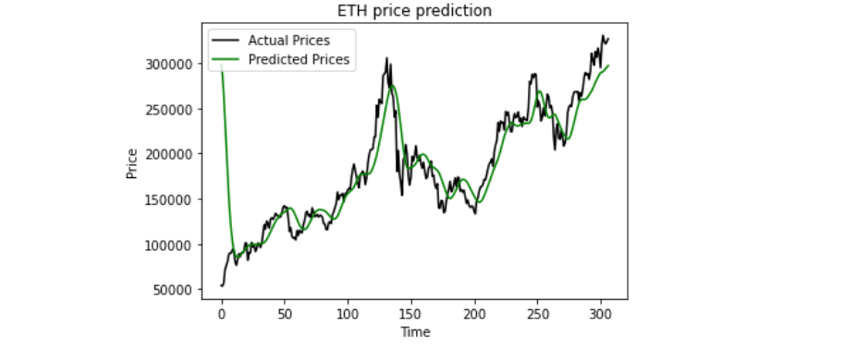
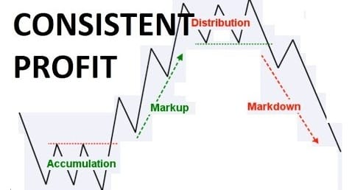
Expected Outcome

Slide 9
Algorithm Used
It works by using special gates to allow each LSTM layer to take information from both previous layers and the current layer.
The data goes through multiple gates and various activation functions and is passed through the LSTM cells.
The main advantage of this is that it allows each LSTM cell to remember patterns for a certain amount of time.

Slide 10
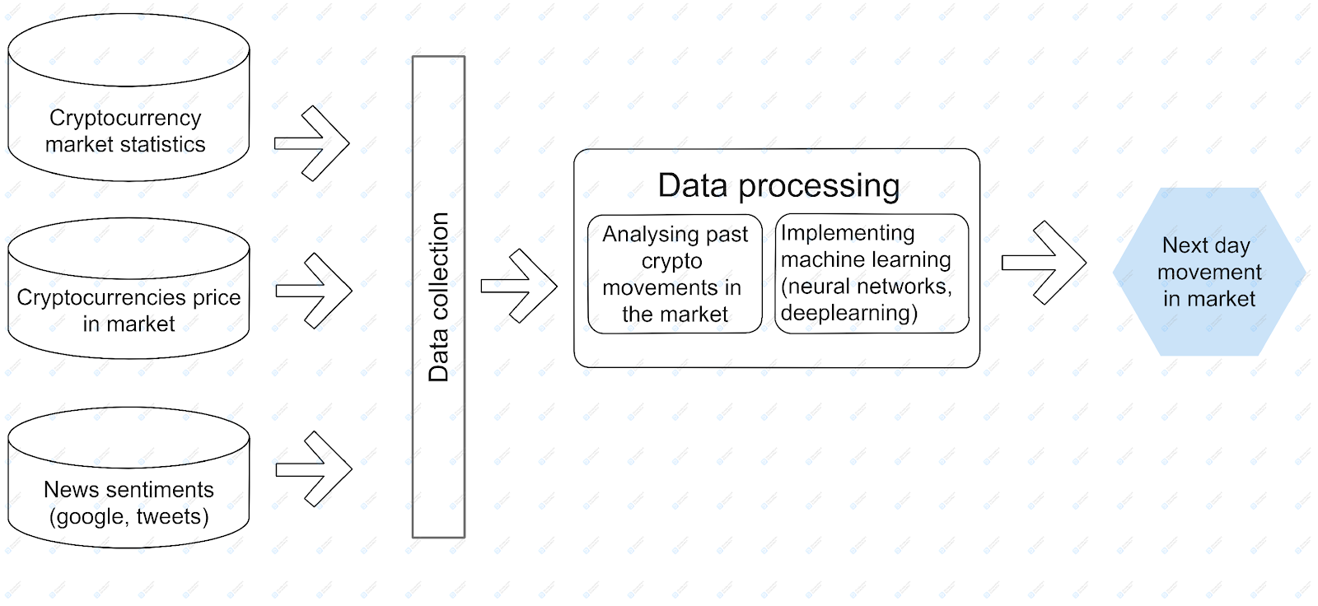
Architecture Diagram

Slide 11
System Requirement Specification
Front end : XML
Backend: JAVA
Hardware Requirement : Android Version 5.0 , 2/4gb RAM

Slide 12
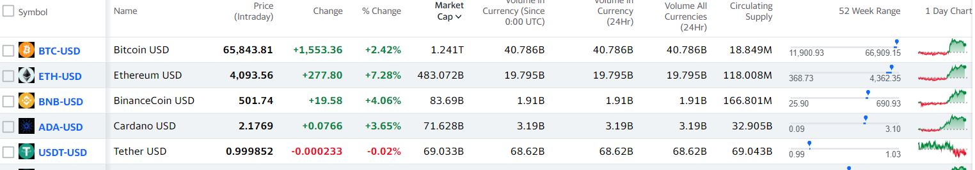
Module Explanation
Importing data :
We use “pandas-datareader” library to import financial data form yahoo finance api.
Yahoo finance is a website which has data of all the markets like crypto, stocks, crude oil…. etc.
We predict the price of the particular crypto currency using it.

Slide 13
Module Explanation
Data pre-processing :
Data pre-processing is a data mining technique which is used to transform the raw data in a useful and efficient format.
So, to avoid wrong predictions of the cryptocurrencies, data has to be analyzed before giving input to the machine learning model.

Slide 14
Module Explanation
Training and Testing :
We split the data into two sets — training set and test set with 80% and 20% data respectively.
we use the training data to fit the model and testing data to test it.
Training and testing set is recorded using “sk learn” python library.
In our project we train 60 days data of the particular coin and predict 61st day using it.
The below commands are used to test the data with actual results.
test_start = dt.datetime(2021, 1, 1)
test_end = dt.datetime.now()
test_data = web.DataReader(f'{crypto_currency}-{against_currency}', 'yahoo', test_start, test_end)

Slide 15
SOLUTION
Thus we have tested the correctness of the selected criteria combination on their effect on the price of Bitcoin. For our experiment, we used Multiple Linear Regression, Random Forests, and LSTM ML algorithms implemented with Python in Anaconda Data Science tool.
As a result, we have found that selected combination of criterion can explain more than 70% of cryptocurrency price. On this base, we plan to study additional criteria which affect prices of cryptocurrencies to be able to forecast their prices more accurate.

Slide 16
REFERENCES

